Slide 1
IN PROGRESS
DOCUMENT AI & GENAI
ClearCustoms AI
Automated parsing and semantic extraction for global trade documentation.
Active Development Phase

Slide 2


THE PROBLEM
Trade Friction
Unstructured Chaos: Thousands of varied invoice formats globally.
Manual Bottlenecks: Slow, error-prone human data entry.
Compliance Risks: Mistyped HS codes trigger costly customs delays.

Slide 3



Core Objectives
Layout Independence
Semantic Reasoning
Structured Output
Extract fields without rigid templates.
Understand context via Generative LLMs.
Generate clean JSON for ERP integration.

Slide 4






Planned Technology Stack
Python
Tesseract /
EasyOCR
LayoutLM
LLM Integration
FastAPI
React UI

Slide 5
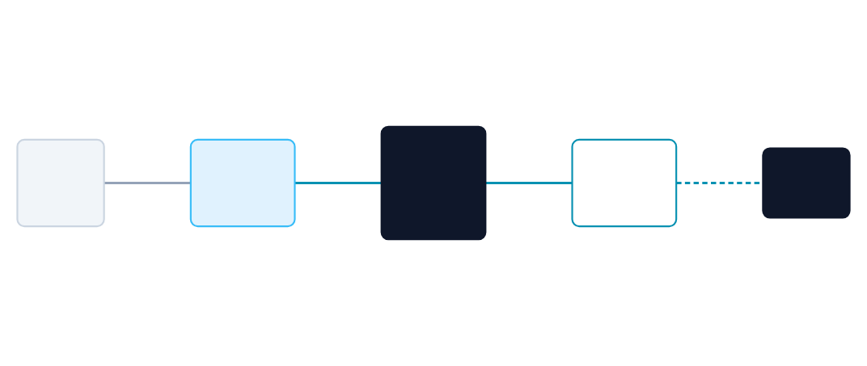
Extraction Pipeline Architecture
GenAI LLM
Raw PDF /
Images
OCR &
Layout Parse
Schema
Validation
JSON

Slide 6




Clearance Workflow
1. Ingest
2. Process
3. Extract
4. Validate
Receive scanned document.
Deskew and OCR bounding boxes.
LLM entity recognition.
Apply customs rules.

Slide 7
Dataset & Preprocessing
Target Documents
Vision Preprocessing
Commercial Invoices.
Automated deskewing algorithms.
Bills of Lading (BoL).
Adaptive binarization.
Detailed Packing Lists.
Background noise reduction.

Slide 8


Hybrid AI Pipeline
Vision & Layout
Generative Parsing
Goal: Spatial awareness.
Goal: Semantic extraction.
Maps text coordinates to preserve the visual hierarchy of complex nested tables.
LLM interprets key-value pairs regardless of visual placement or varying terminology.

Slide 9

Review Dashboard
Human-in-the-loop interface comparing source documents alongside structured AI extractions.
Confidence Scoring.
One-click correction.
Direct ERP export.

Slide 10
Current Challenges
OCR Limitations
Generative Parsing
Low DPI Scans: Illegible micro-text.
Hallucinations: Inventing missing HS codes.
Watermarks: Interference with character recognition.
Nested Tables: Misalignment of multi-page line items.

Slide 11
Technical Q&A
1. Why not use standard Regex rules?
4. Handling multi-page tables?
Invoices have infinite layout variations; Regex is too brittle.
Chunking by visual separators and merging entity arrays post-extraction.
2. How to prevent LLM hallucinations on numbers?
Enforce strict JSON schemas and ground extraction via temperature=0.
5. How do you validate the output?
Cross-referencing extracted totals against mathematical sums of line items.
3. Advantage of LayoutLM over standard OCR?
Embeds spatial coordinates alongside text for 2D visual context.

Slide 12
Frictionless Global Trade.
Transforming legacy supply chain documents into structured, actionable intelligence.
Repository: Private / WIP
tmthangaraj1980

Slide 13


Image Sources
https://d3lkc3n5th01x7.cloudfront.net/wp-content/uploads/2023/12/28004739/AI-in-Customs-Clearance.png
Source: www.leewayhertz.com
https://media.licdn.com/dms/image/D4D12AQExyO-o8F-PMA/article-cover_image-shrink_720_1280/0/1691157956041?e=2147483647&v=beta&t=37yT-F3o3g4oF6H8iR-uH-j1V4nE9V_D_3M190yA8zE
Source: www.linkedin.com
https://cdn.dribbble.com/userupload/45788503/file/b1676f6d71c218be5825d216432d1398.png?resize=752x&vertical=center
Source: dribbble.com

